Slide 1
Welcome to Key Stage One

Slide 2
Future Events
Y1 Phonics/Maths workshops
Dates TBC
Y2 Maths/Reading workshops
Dates TBC
KS1 Christmas ‘Crafternoon’
16th December at 2pm
Year 2 Christmas performance
4th December 2019 -10am and 5.30pm
Y1 Christingle Service at St Francis Church
12th December 2019 – 2pm
Whole School Crazy Christmas Dress up day
20th December 2019
Y2 SATs meeting (Spring Term – date TBC)
Notes:
EB

Slide 3
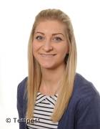
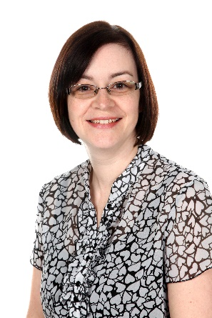
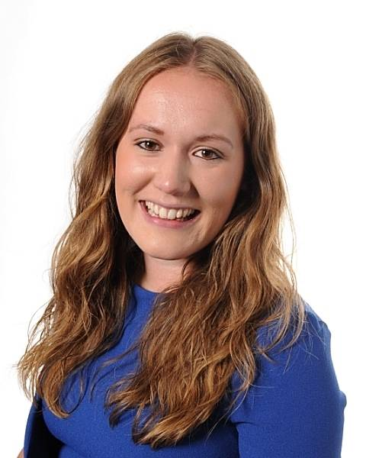
Teaching staff 2018/19
Mrs Brand (Team Leader)
Y2
Mrs Neave
Y2
Mrs Richardson/Miss Head
Y2
Miss Atkinson
Y1
Mr Nixon
Y1
Mrs Ripley
Y1
Notes:
EB

Slide 4
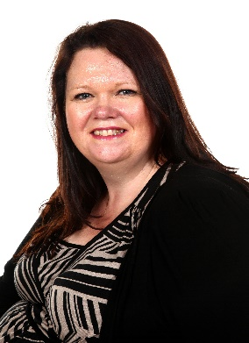
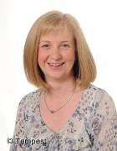
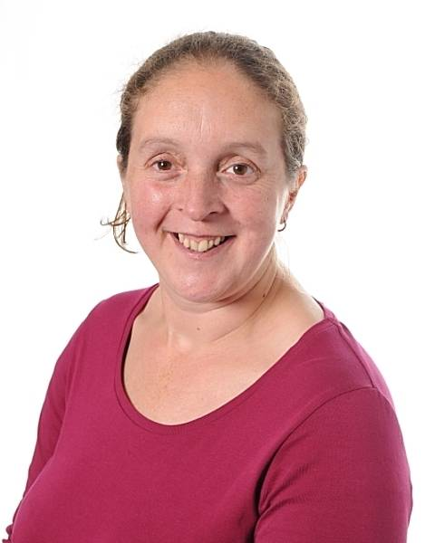
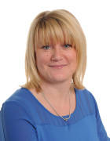
Teaching assistants
Mrs Eglinton
Y2
Mrs Stephenson
Y2
Mrs Ellis
Y2
Miss Farrell
Y1
Mrs Conway
Y1
Mrs Myers
Y1
Mrs Dawson
Y1
Notes:
EB

Slide 5
What is Key Stage One?
Year One and Year Two.
Children move from the Foundation Stage Curriculum to the National Curriculum.
Year 1 - 90 places split between three classes taught by:
Mr Nixon, Miss Atkinson and Mrs Ripley
Year 2 - 90 places split between three
classes taught by:
Mrs Brand, Mrs Neave, Mrs Richardson and Miss Head
Year 1 and Year 2 plan their teaching activities as a team and agree topics collectively.
Each teacher will have half a day planning time – Tuesday pm for Y1 and Wednesday am for Y2.
Your child will work with staff from across the three classes as well as staff throughout the Key Stage.
Notes:
EB

Slide 6
Daily Routine – KS1
am |  |  |  | pm
Morning Learning | English | Maths | Phonics | Guided Reading | Other Subjects – Science, History, Geography, P.E, Computing, Art, RE, French, PSCHE
Children complete morning learning tasks beginning at 8:45 when the doors open. Punctuality is key for children to access this learning.
Y1 Homework and Spellings – Set on a Friday due in on a Wednesday
Y2 Homework and Spellings – Set on a Wednesday due in the following Wednesday.
Notes:
EB

Slide 7
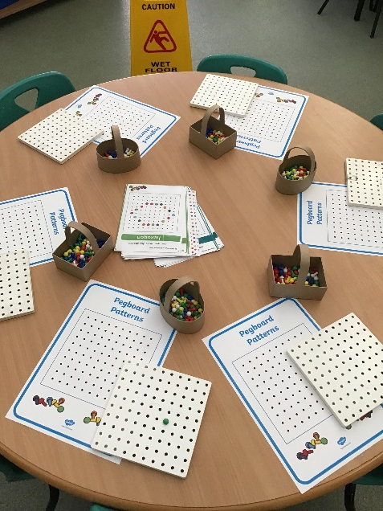
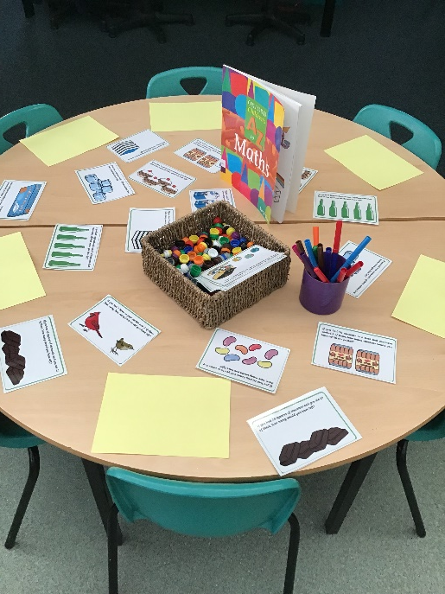
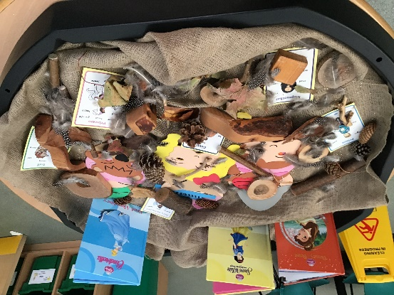
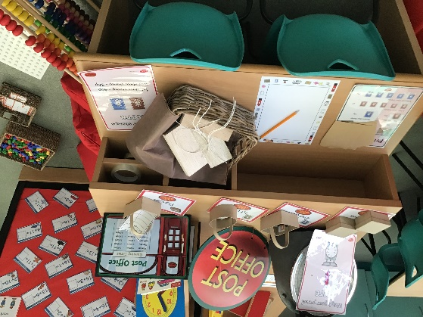
Enquiry Based Learning
We recognise the importance of learning through play in KS1. Children in Year One will still have access to enquiry based learning opportunities. These will be focused around specific objectives which are changed on a fortnightly basis.
Notes:
EB

Slide 8
Successful Learners
We want your child to enjoy coming to school so the following things are really important.
Attendance – anything below 90% is now below expectation. In a six week half term, this means anything in excess of 3 days is below national expectations.
A good night’s sleep
Breakfast and hydration
Independent, self-motivated learners
Active participants
Ask questions
Willing to take a risk
Notes:
MA
Attendance is so important – no work can be sent home to ‘catch up’ as the teaching is on-going and one day feeds into the next.
Behaviour is not an issue – we do expect and promote the following learning behaviours
Sense of perseverance

Slide 9
What will your child be learning?
Here at Barley Fields we aim to provide a broad and balanced curriculum. Children access the following areas of learning which all link to our topics. These topics change each half term.
Core Subjects Foundation Subjects:
Maths Computing
English Science
Science History
Geography
PE Music
Art
Design and Technology
Religious Education
Personal, Social and Health education
French
Notes:
MA

Slide 10
What will your child be learning?
English
Reading
Daily Phonics Teaching in Y1 and Y2 – Letters and Sounds programme.
Daily guided reading sessions with a teacher.
Book band levels – children will move through these once they have completed all objectives in that band.
Individual reading opportunities 1:1 with an adult.
Whole class reading sessions (Reading Buddies)
Year Two reading for understanding – focus on inference and deduction through reading comprehensions etc.
Class readers
Notes:
MA

Slide 11
Guided Reading
Your child will read in a guided reading group once a week with their teacher. They will work with a small number of children to analyse a text in detail, making sure each child can read each word and discussing meaning of the text with them.
Children will be divided into ability groups, according to their reading levels. The teacher will choose a set of books for the group she or he is reading with, that is appropriate to their level.
Two parts of a guided reading session:
Decoding - literally turning a written word into a spoken word. Teachers will teach children how to decode by encouraging them to split a word up and sound out all the separate sounds. They may also ask them to look at the picture to help them.
Comprehension - understanding what has been read and being able to talk or write about it.
Notes:
MA

Slide 12
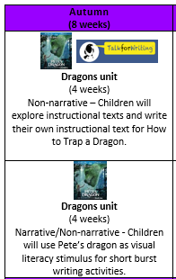
What will your child be learning?
English
Writing
Talk 4 Writing, Read Write Perform and ‘short burst’ writing opportunities.
Emphasis on immersion in reading
Emphasis on audience and purpose
Spelling rules and HFW focus
Y1 Example
Y2 Example
Notes:
PN

Slide 13
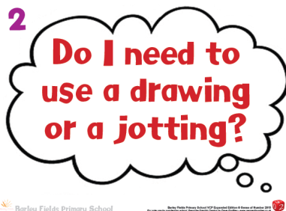
What will your child be learning?
Maths
Our Maths planning focuses on the Maths Mastery approach. We follow the White Rose Hub scheme which is underpinned and mirrored in our ethos that everyone can succeed in mathematics.
Maths teaching and learning is developed through:
Fluency
Reasoning
Problem solving.
Maths areas covered throughout the year:
Number and Place Value
Four Operations – Addition, Subtraction, Multiplication and Division
Measurement: Length, mass and capacity
Money
Time
Notes:
PN

Slide 14
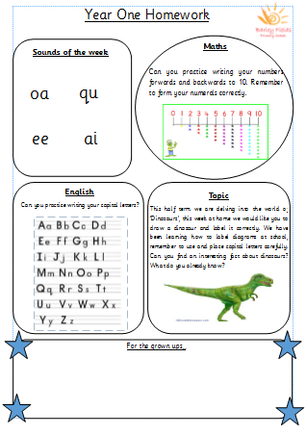
Home learning
Children are expected to read frequently at home (3x per week) and for adults to make a comment in their home school reading record.
To learn spellings every week (weekly lists are set on )
Notes:
PN

Slide 15
Topics
Topics are primarily History and Geography focused and we link other curriculum areas to these topics.
Please visit our website for full curriculum coverage where you can see our long term planning
Notes:
Emma

Slide 16
Theme Days
To enrich our curriculum we have theme days in order for children to learn more about the world around them.
This term our theme days are:
World Mental Health Day (10.9.19)
Diwali (24.10.19)
Bonfire Night (5.11.19)
Remembrance day (11.11.19)
Notes:
Emma

Slide 17
At the end of the day…
All children MUST be collected by a familiar adult (over the age of 16 years). If somebody else is collecting your child for any reason, it is important that school know. We will not be able to send your child with an adult who doesn’t normally pick them up unless we are aware of it.
Children will be prepared for home-time in the classroom prior to bell ringing and are then brought out under direct teacher supervision – please be patient as it can take a little while for everyone to be ready and to match children up with their parents!
Notes:
Emma

Slide 18
Medical Matters
Inhalers: one to be kept in school
School can only give children medicine that has been prescribed by the doctor. This is to be taken to the main office and it will be kept in the fridge. It must be collected by a parent at the end of the school day. We can only administer medicine which has to be taken four times a day.
If you have any concerns about medical issues please speak to a member of staff.
Notes:
Phillipa

Slide 19
Special Educational Needs
If you have any concerns about your child’s development please speak to their class teacher or Mrs Gregory/Mrs Neave (SENCO)
Notes:
Phillipa

Slide 20
THANK YOU FOR COMING.

