Slide 1







End Of Key Stage Two
SATS
Please take a sheet from the front!

Slide 2


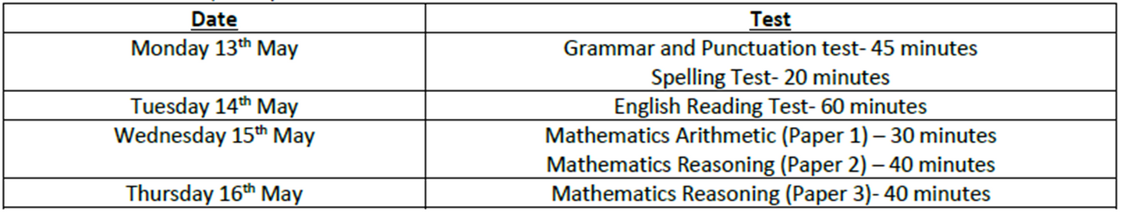
Introduction
SATs are the Standard Assessment Tests that are given to children at the end of KS2.
The SATs take place over 4 days.

Slide 3

They test the whole of the KS2 curriculum- not just Year 6!
They only test a child’s English and Maths knowledge.
Designed to provide information about how your child is progressing, compared to children the same age nationally.
They are not qualifications – they do not affect your child’s future options at school.
The tests last from 30-60 minutes each and children have to show what they know in this time.
Results are used to ensure schools are teaching their pupils essential knowledge and skills that are the early building blocks.
The tests can be used to set targets for children to achieve by the end of secondary school.

Slide 4

What Will The Week Look Like?
The tests can be sat at any point during that day. We complete them in the morning.
We will have a break and short revision first.
Adults can read the questions to the children if they put their hands up and ask.
Owing to usual classroom practice, some children will sit their tests in smaller groups.
If you have any questions about this, please contact your child’s class teacher.
Most children will be in the hall.
Some children, who may require additional arrangements, may be in classrooms.

Slide 5
The Results
Tests are marked externally.
They will be reported to you with your child’s end of year report.
Children will either have met Age Related Expectations (Expected) or not.
You will be able to tell how well your child has done by the scaled score you receive.
Results are reported for:
Spelling, punctuation and grammar.
Reading
Maths

Slide 6
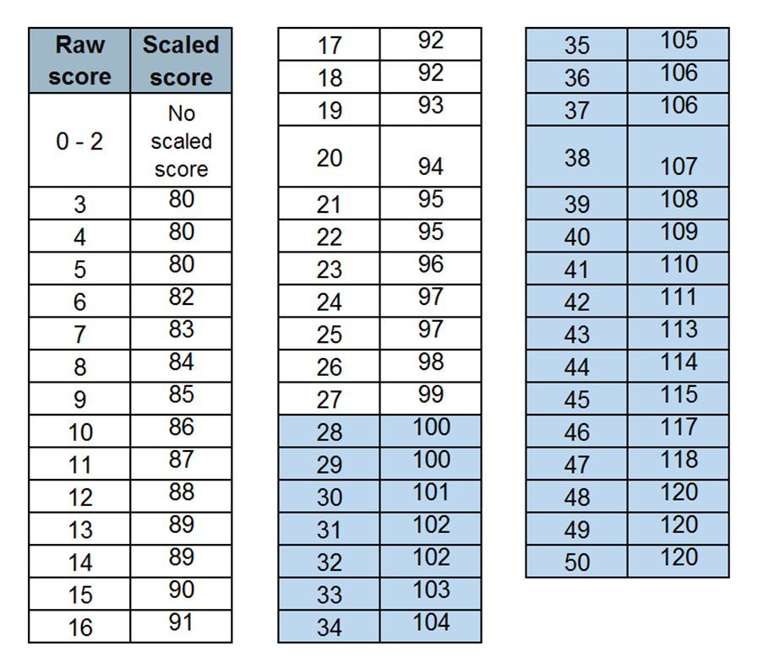
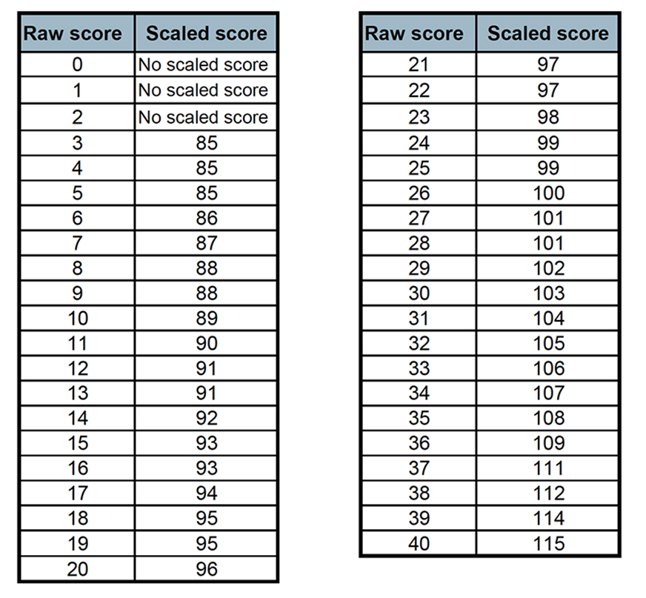
Scaled Scores

Slide 7




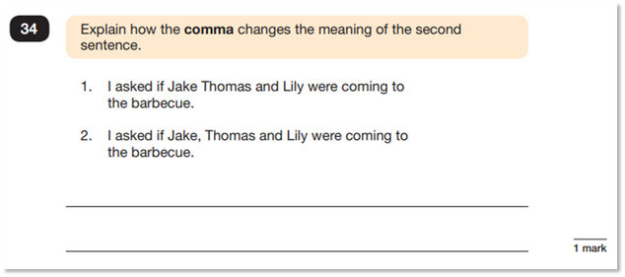
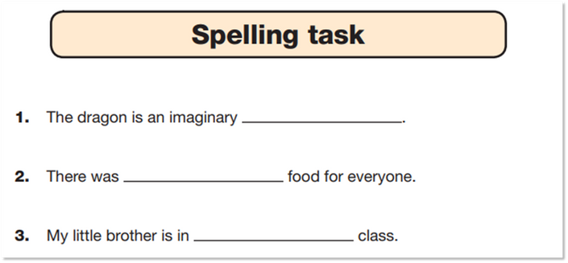

SPAG
1
3
How To Prepare
Grammar
2
Spelling
Questions and written (50 marks)
45 minutes
Spelling Test (20 marks)- 15 mins

Slide 8
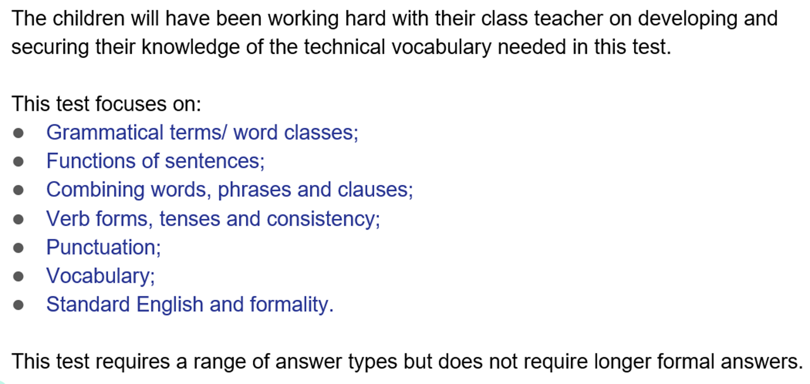
SPAG

Slide 9
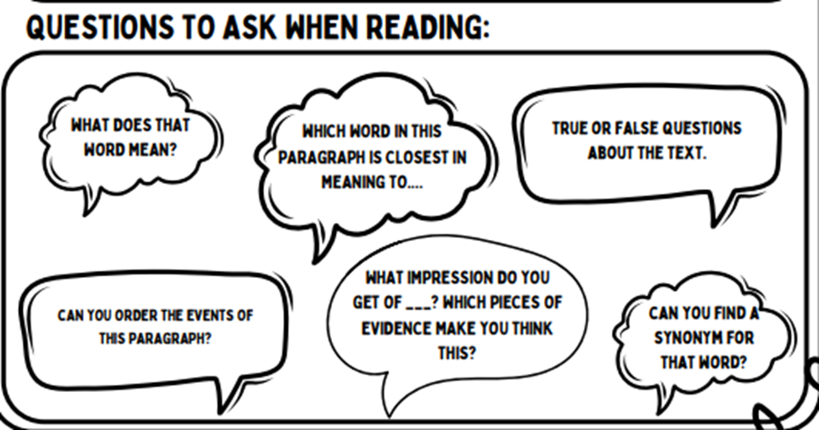
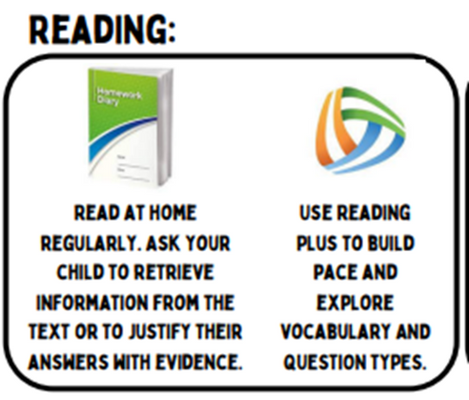
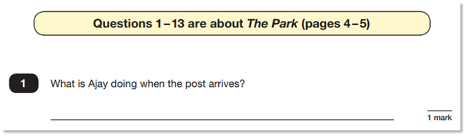
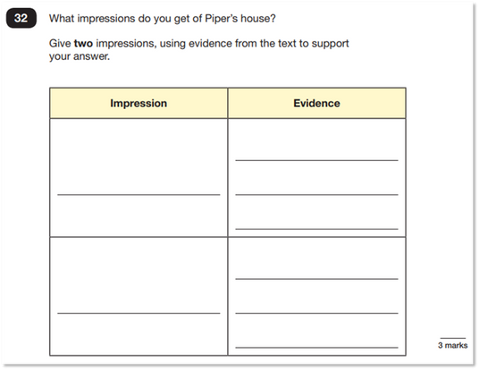
Reading
1
Reading
2
How To Prepare
One test paper (50 marks)- 60 mins
Three texts to read and an answer booklet to complete

Slide 10
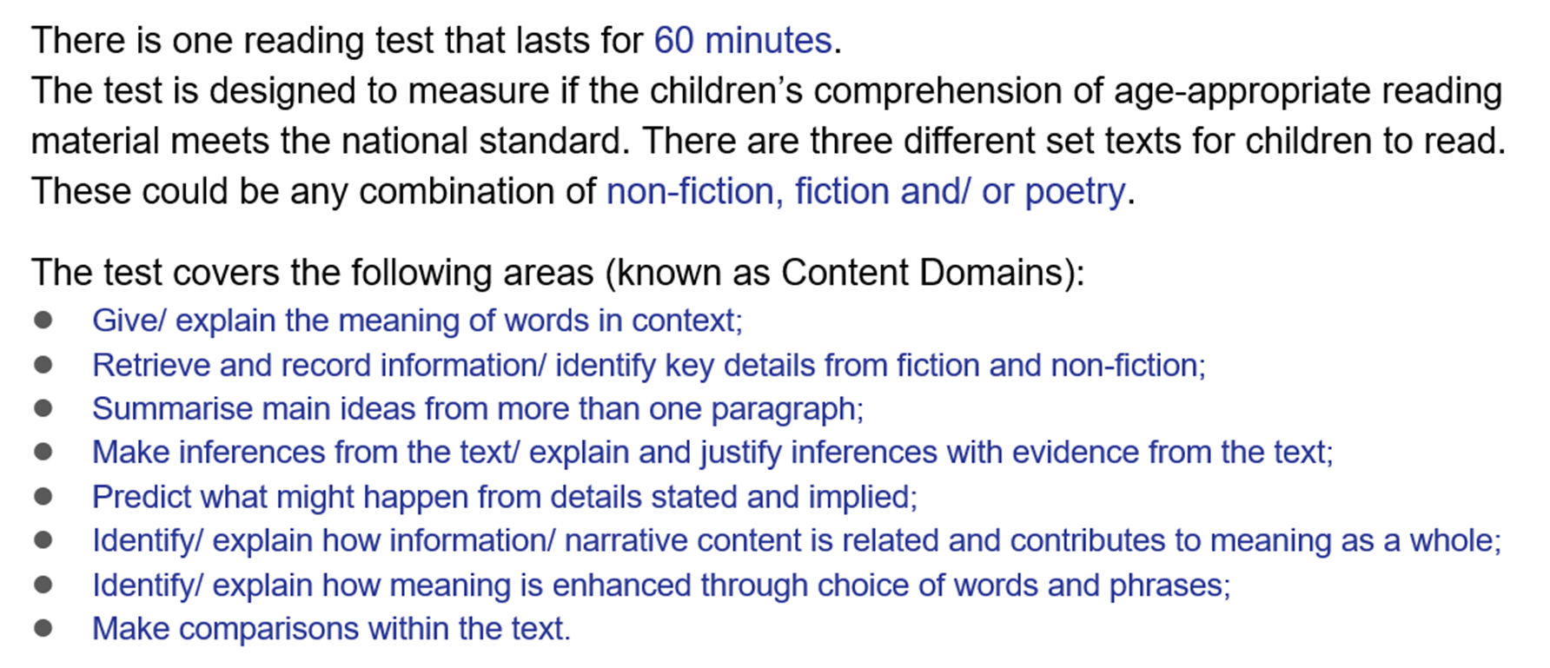
Reading

Slide 11
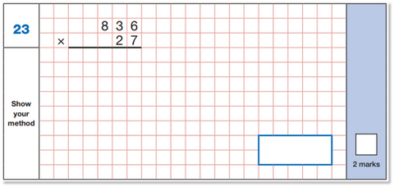
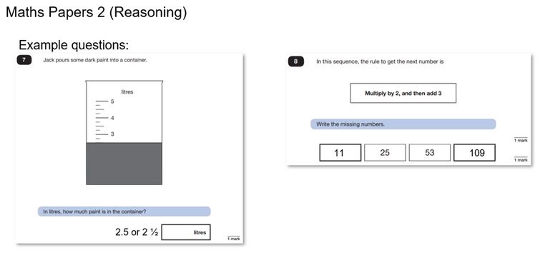
Maths
1
3
Arithmetic
How To Prepare
2
Reasoning A and B
Paper 1 Arithmetic - 40 marks (30 minutes)
Paper 2 Reasoning - 35 marks
(40 minutes)
Paper 3 Reasoning - 35 marks (40 minutes)

Slide 12
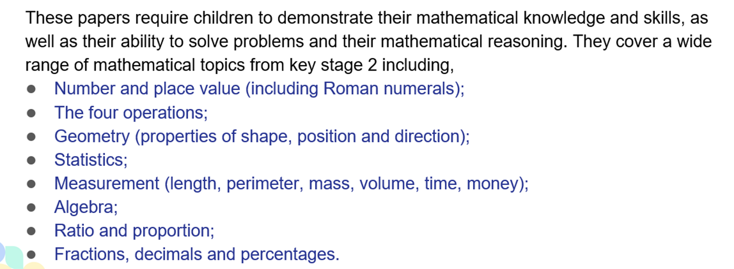
Maths

Slide 13

Assurance
Extra support
Children should know that trying their best is what matters!
Additional adult support and focused interventions.
Practise papers
Engaged and Involved
We will use them in school- please refrain from doing so at home or use them once we have done them
Children are actively involved in lessons and want to do well!
Timetable Changes
Boosters and Breakfast club
Practise papers and revision built into our timetable.
Starting after Easter- further information to follow.

Slide 14
How Can You Help?
1
3
Well-being
5
Try Their Best!
Support Learning
A good night’s sleep, a healthy breakfast, water bottle and enjoying activities outside of learning are all important for the children to do in the run up to SATS as well as during our SATs week!
Assure the children that the tests are nothing to worry about and they just should try their best!
Read messages in Homework Diaries.
Use the websites outlined to help children revise.
Make the most of real-life opportunities to reinforce skills.
Ask your children what they have learned today: what might they need more support with?
Practise times tables regularly.
Make posters to support learning at home.
Support your child in completing their home learning and let us know if they are struggling with anything.
2
Attendance
4
Reading
Being at school as much as possible means that we can support your child.
Make the most of opportunities to read and clarify or explore vocabulary.

Slide 15



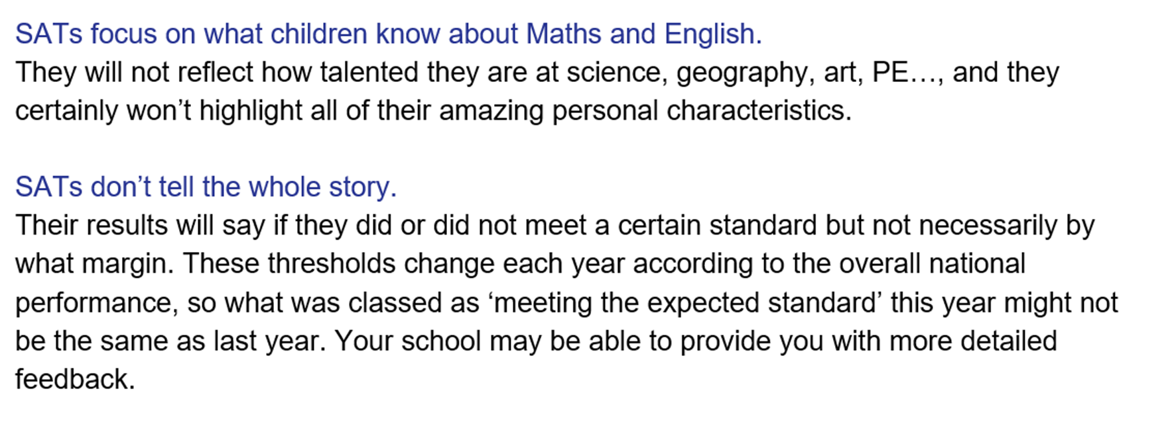
Remember:

Slide 16
Writing
There is no writing SATs test.
Writing is assessed by the teacher over a period of time across a range of genre against the interim statements provided.
To demonstrate that pupils have met a standard within this interim framework, teachers will need to have evidence that a pupil demonstrates attainment of ALL of the statements within that standard and ALL the statements in the preceding standard(s).
Open to external moderation from the Local Authority.

Slide 17


Thanks!
Thank you for coming.
As ever, we appreciate your continued support
If you have any further questions, or would like anything clarifying, please email your child’s class teacher.

